Slide 1
Credit Score Classification

Slide 2
Classification
Banks and credit card companies calculate your credit score to determine your creditworthiness. It helps banks and credit card companies immediately to issue loans to customers with good creditworthiness. Today banks and credit card companies use Machine Learning algorithms to classify all the customers in their database based on their credit history.
There are three credit scores that banks and credit card companies use to label their customers:
1 Good
2 Standard
3 Poor

Slide 3
A person with a good credit score will get loans from any bank and financial institution. For the task of Credit Score Classification, we need a labelled dataset with credit scores.

Slide 4
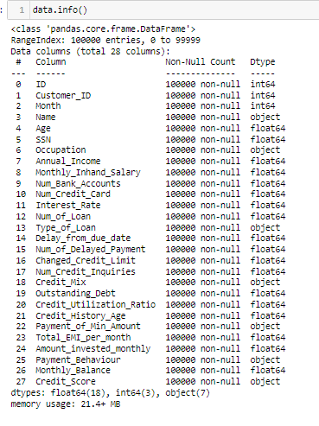
df.info()

Slide 5
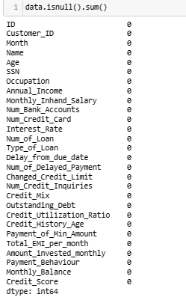
Before moving forward, let’s have a look if the dataset has any null values or not
The dataset doesn’t have any null values.

Slide 6

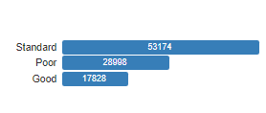
As this dataset is labeled, let’s have a look at the Credit_score column values

Slide 7
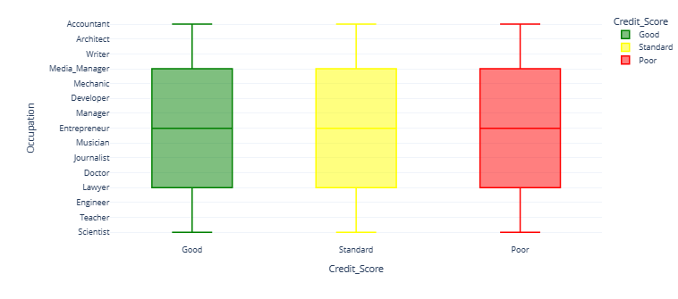
checking if the occupation of the person affects credit scores
There’s not much difference in the credit scores of all occupations mentioned in the data

Slide 8
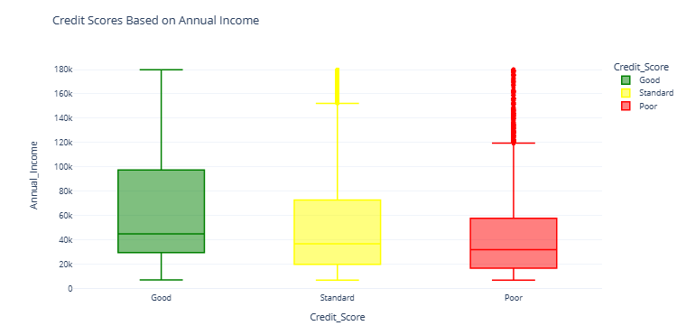
Now let’s explore whether the Annual Income of the person impacts your credit scores or not
According to the visualization, the more you earn annually, the better your credit score is

Slide 9
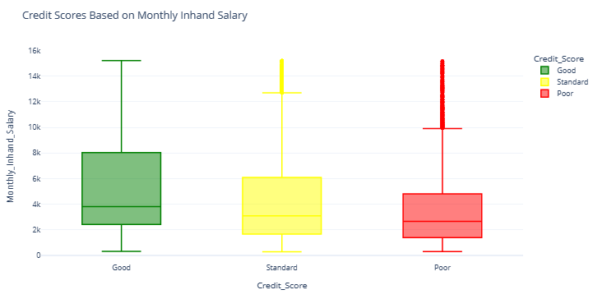
Now let’s explore whether the monthly in-hand salary impacts credit scores or not
Like annual income, the more monthly in-hand salary you earn, the better your credit score will become.

Slide 10
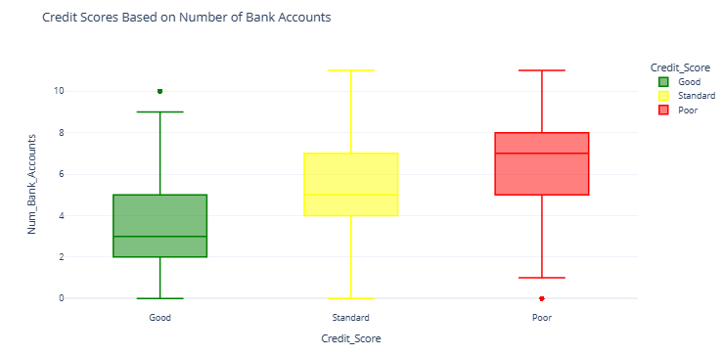
Now let’s see if having more bank accounts impacts credit scores or not
Maintaining more than five accounts is not good for having a good credit score. A person should have 2 – 3 bank accounts only. So having more bank accounts doesn’t positively impact credit scores.

Slide 11
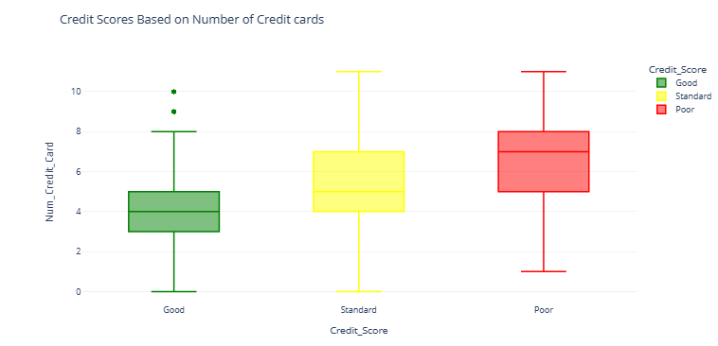
Now let’s see the impact on credit scores based on the number of credit cards you have
Just like the number of bank accounts, having more credit cards will not positively impact your credit scores. Having 3 – 5 credit cards is good for your credit score

Slide 12
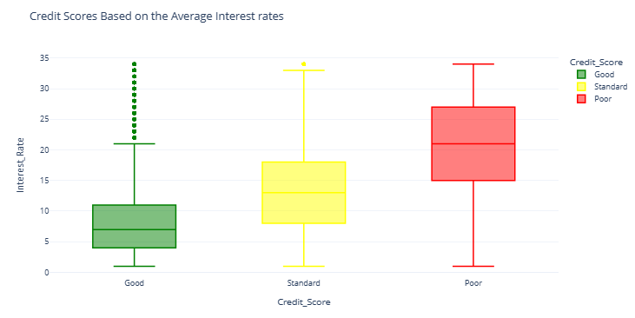
Now let’s see the impact on credit scores based on how much average interest you pay on loans and EMIs
If the average interest rate is 4 – 11%, the credit score is good. Having an average interest rate of more than 15% is bad for your credit scores

Slide 13
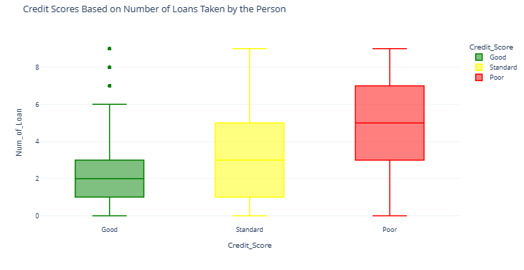
Now let’s see how many loans you can take at a time for a good credit score
To have a good credit score, you should not take more than 1 – 3 loans at a time. Having more than three loans at a time will negatively impact your credit scores.

Slide 14
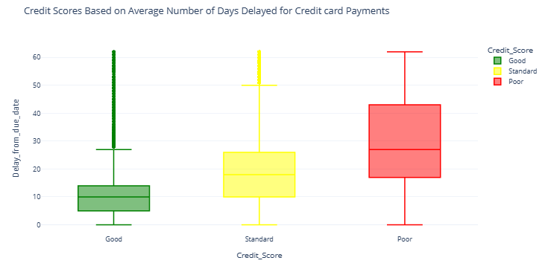
Now let’s see if delaying payments on the due date impacts your credit scores or not
So you can delay your credit card payment 5 – 14 days from the due date. Delaying your payments for more than 17 days from the due date will impact your credit scores negatively.

Slide 15
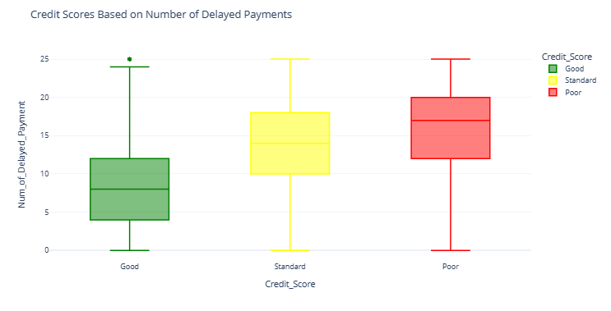
Now let’s have a look at if frequently delaying payments will impact credit scores or not:
So delaying 4 – 12 payments from the due date will not affect your credit scores. But delaying more than 12 payments from the due date will affect your credit scores negatively.

Slide 16
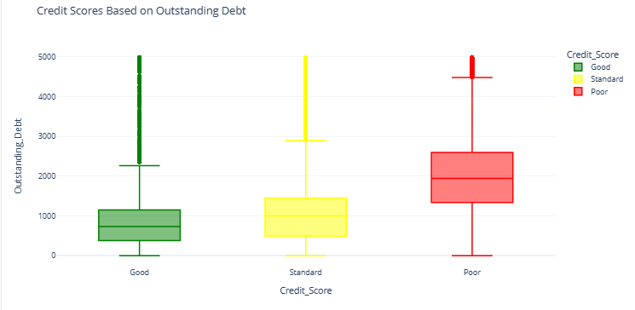
Now let’s see if having more debt will affect credit scores or not:
An outstanding debt of 380 – 1150 will not affect your credit scores. But always having a debt of more than 1338 will affect your credit scores negatively.

Slide 17
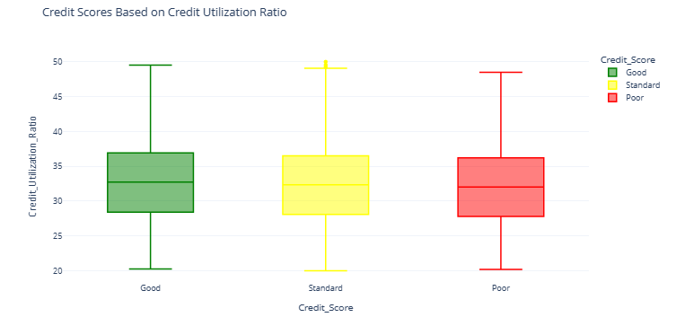
Now let’s see if having a high credit utilization ratio will affect credit scores or not:
Credit utilization ratio means your total debt divided by your total available credit. According to the above figure, your credit utilization ratio doesn’t affect your credit scores

Slide 18
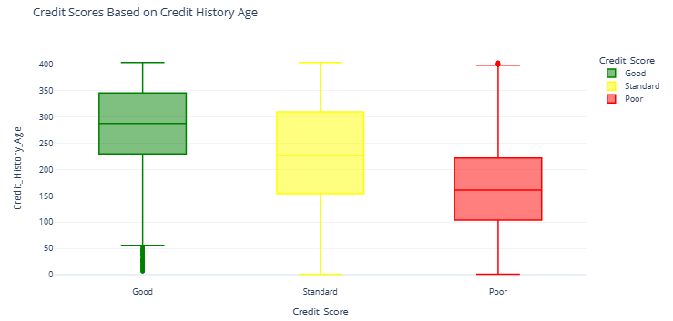
Now let’s see how the credit history age of a person affects credit scores
So, having a long credit history results in better credit scores.

Slide 19
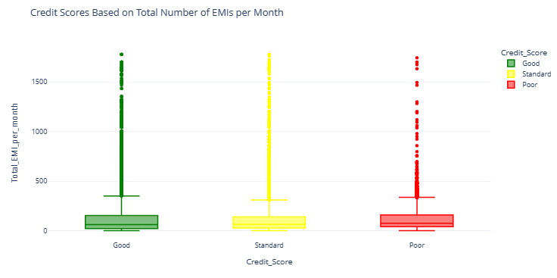
Now let’s see how many EMIs you can have in a month for a good credit score:
The number of EMIs you are paying in a month doesn’t affect much on credit scores.

Slide 20
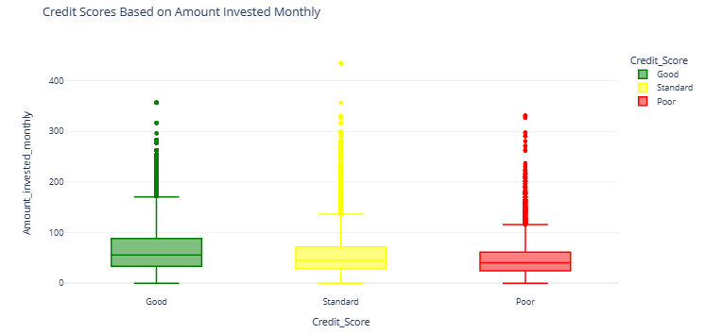
Now let’s see if your monthly investments affect your credit scores or not:
The amount of money you invest monthly doesn’t affect your credit scores a lot.

Slide 21
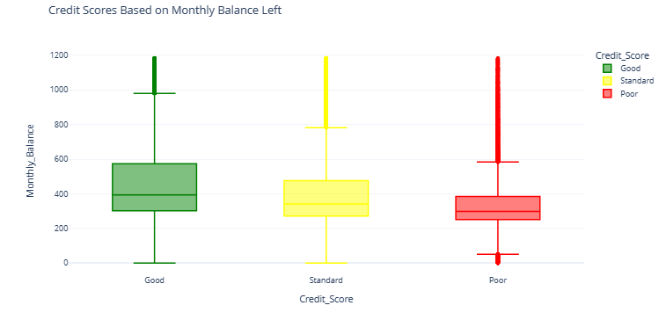
Now let’s see if having a low amount at the end of the month affects credit scores or not:
So, having a high monthly balance in your account at the end of the month is good for your credit scores. A monthly balance of less than 250 is bad for credit scores.

Slide 22

Credit Score Classification Model
One more important feature (Credit Mix) in the dataset is valuable for determining credit scores. The credit mix feature tells about the types of credits and loans you have taken.
As the Credit_Mix column is categorical, we can transform it into a numerical feature so that we can use it to train a Machine Learning model for the task of credit score classification

Slide 23
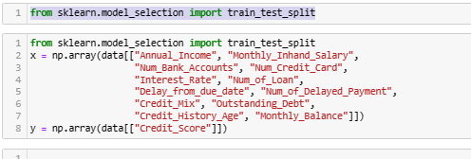
Now split the data into features and labels by selecting the features we found important for our model:

Slide 24
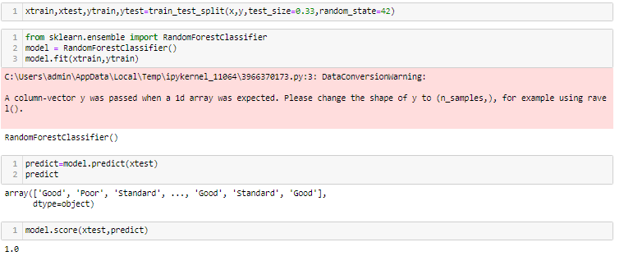
Now, let’s split the data into training and test sets and proceed further by training a credit score classification model:

Slide 25
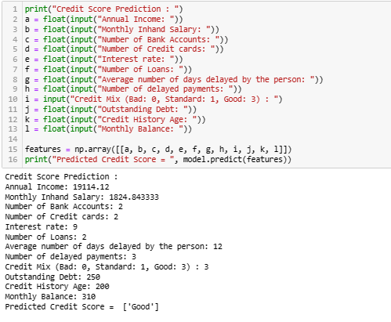
Now, let’s make predictions from our model by giving inputs to our model according to the features we used to train the model:

Slide 27
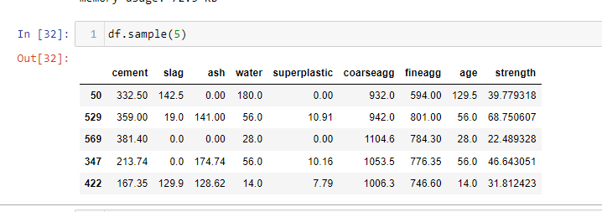
Know your data

Slide 28
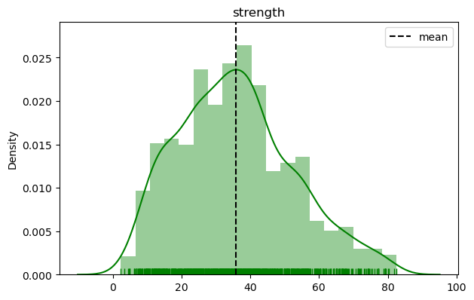
Target Variables

Slide 29
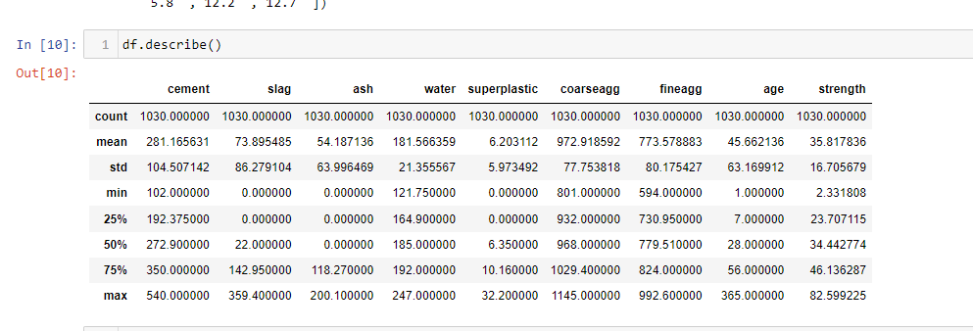
Numerical Variables

Slide 30
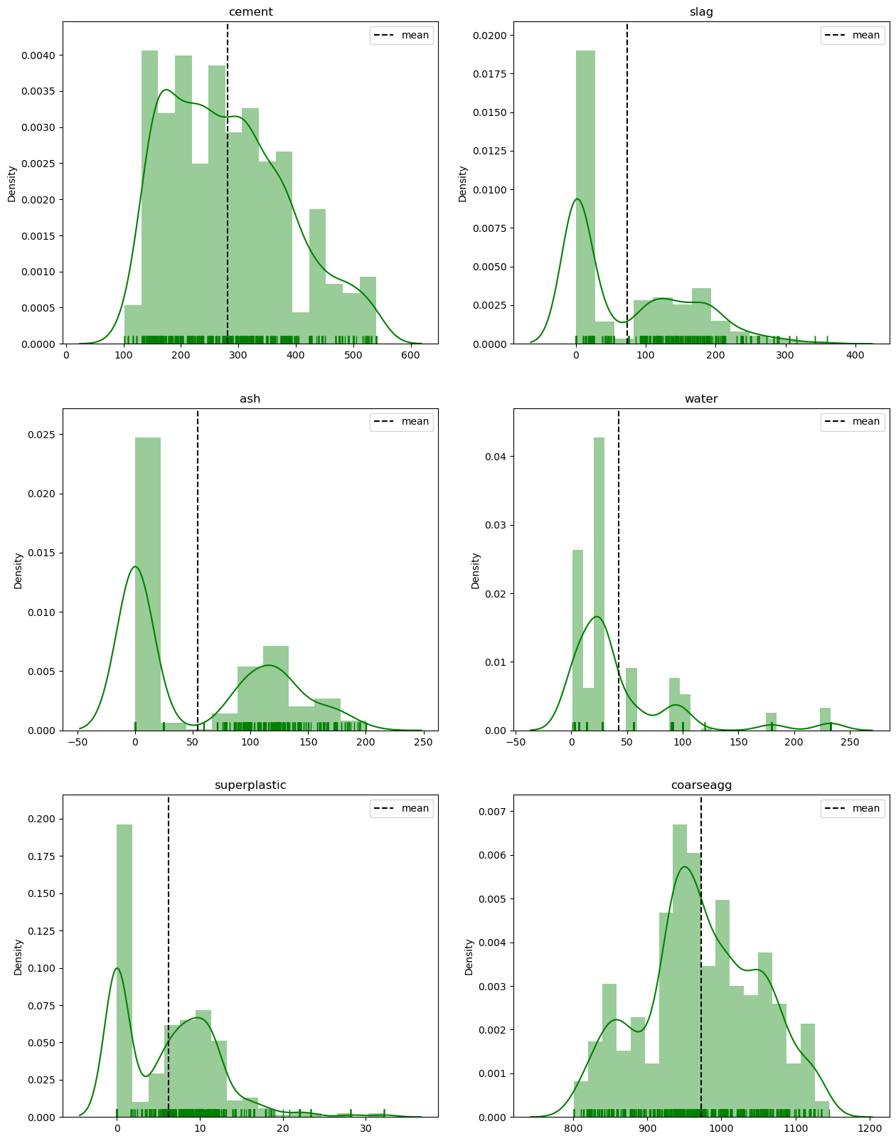

Slide 31
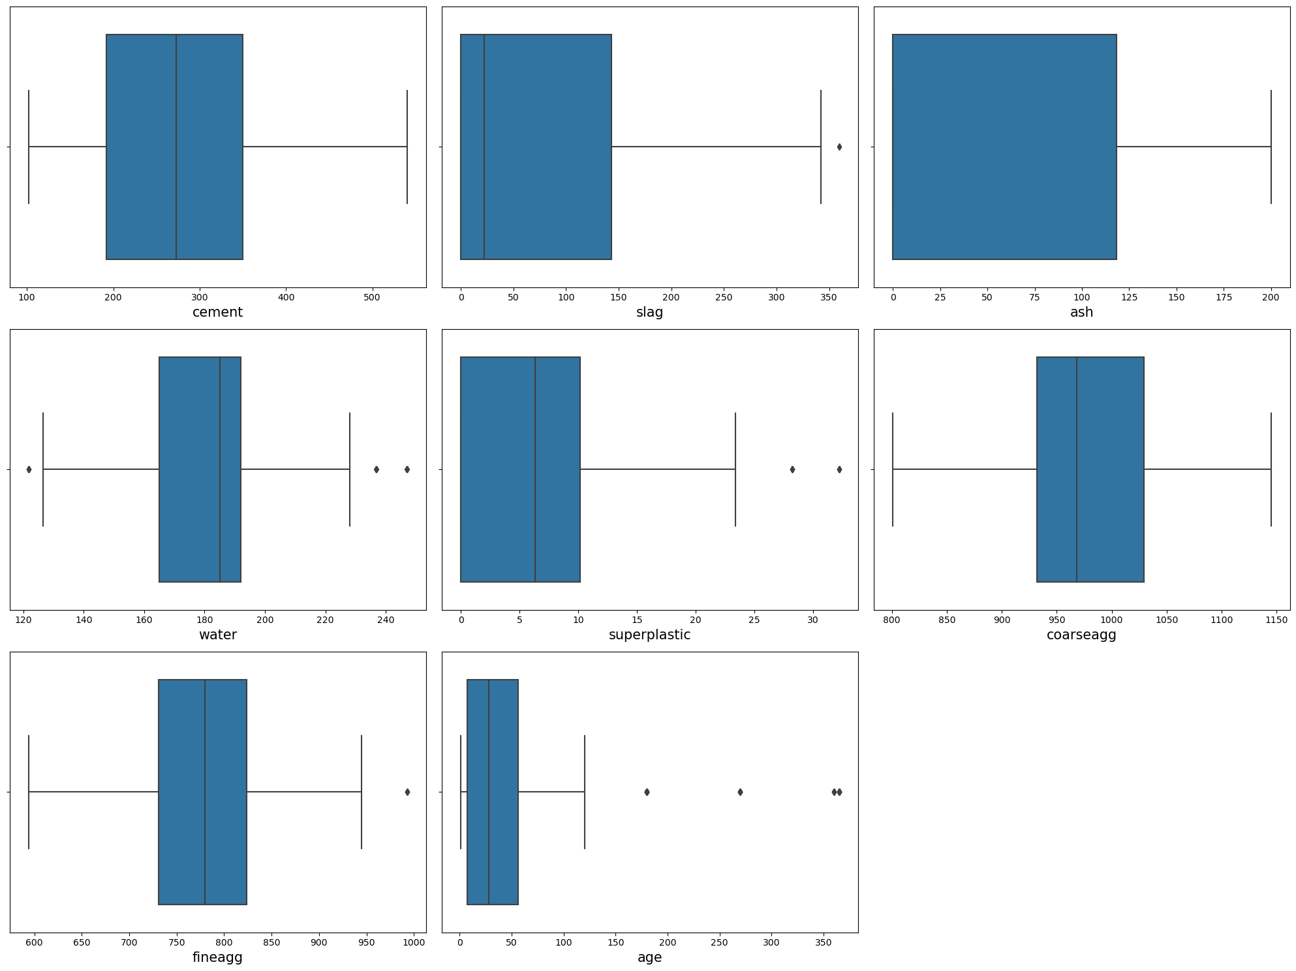
Discrete Variables

Slide 32
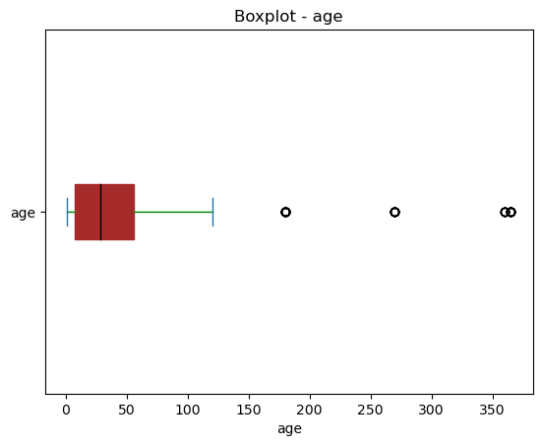
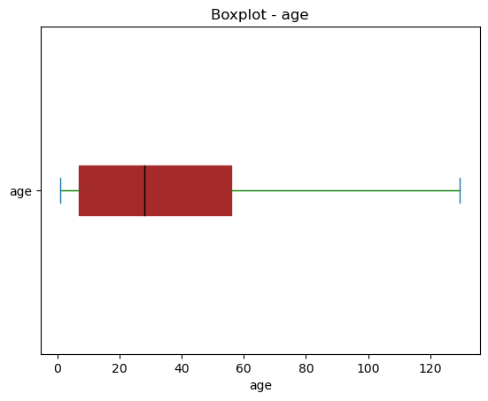
Removing outliers

Slide 33
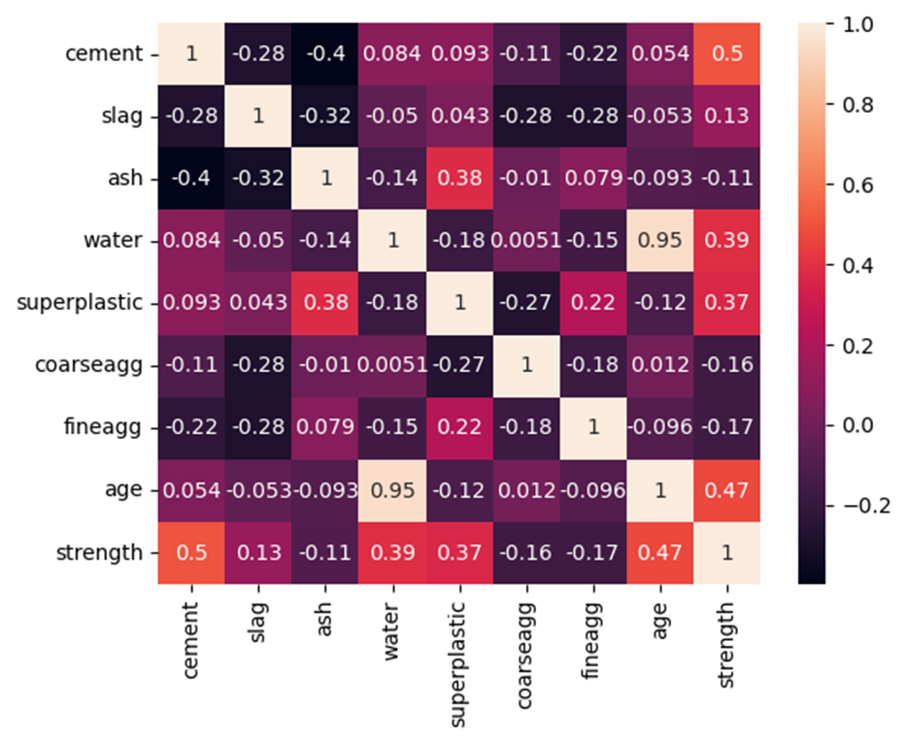
Heat map

Slide 34
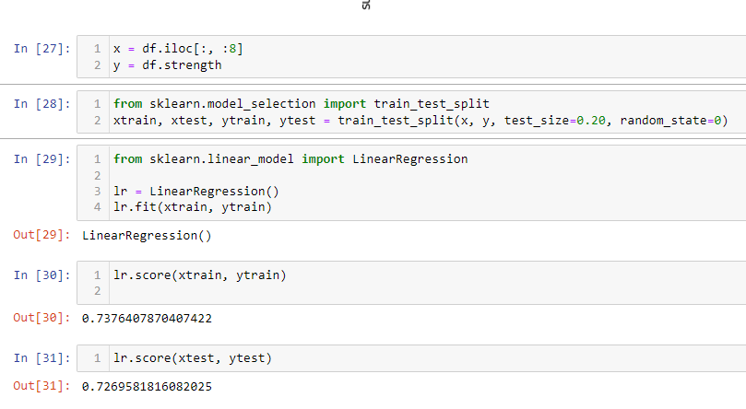
Splitting train test and building the model

